Slide 1
SIC030 - PPT - SESI ke 9 Sistem Perdagangan Elektronik
Social Commerce
and Online Advertising
M HANIF JUSUF ST MKOM

Slide 2
Learning Objectives
Describe the objectives of Social Commerce and Web advertising and also its characteristics.
Describe the major advertising methods used on the Web.
Describe various online advertising strategies and types of promotions.
Describe the issues involved in measuring the success of Web advertising as it relates to different pricing methods.

Slide 3
Learning Objectives (cont.)
Describe permission marketing, ad management, localization, and other advertising-related issues.
Understand the role of intelligent agents in consumer issues and advertising applications.
Understand the problem of unsolicited ads and possible solutions.

Slide 4
Web Advertising Strategy Helps P&G Compete
The Problem
To survive, consumer goods companies must constantly research the markets, develop new products, advertise, advertise, and advertise
Proper advertising strategy, including Web advertising, is critical to the welfare of any company in the consumer goods industry
P&G’s business problem is how to best use its advertising budget to get the most marketing “bang for its bucks”

Slide 5
Web Advertising Strategy Helps P&G Compete (cont.)
The Solution
P&G started to advertise on the Internet in the late 1990s
By 2000, it had 72 active sites, mostly one site for each product
P&G’s major objective is to build around each major product a community of users on the Web

Slide 6
Web Advertising Strategy Helps P&G Compete (cont.)
Objectives in building and maintaining these sites:
developing brand awareness and recognition (brand equity)
collecting valuable data from consumers
cutting down on advertising costs
conducting one-to-one advertisement
experimenting with direct sales of commodity-type products
selling customized beauty products to individuals

Slide 7
Web Advertising Strategy Helps P&G Compete (cont.)
Approach includes:
research
development
investment in hundreds of products simultaneously
developing marketing partnerships
investing in promising start-ups
joining Transora.com, a B2B marketplace consortium

Slide 8
Web Advertising Strategy Helps P&G Compete (cont.)
Uses interactive sites to conduct data mining on Web data
build brand equity and awareness
test the waters for direct sales to customers
collect valuable data from consumers
Information helps
curtail marketing and advertising expenses by enabling the company to target consumers more precisely and economically

Slide 9
Web Advertising Strategy Helps P&G Compete (cont.)
The Results
most improvements achieved by its Web advertising strategy are qualitative
P&G also did extremely well during the economic downturn of 2000–2003
Its stock price climbed about 50%, whereas the average stock price on the New York Stock Exchange dropped over 30%

Slide 10
Web Advertising Strategy Helps P&G Compete (cont.)
What we can learn…
Issues related to online advertising
advertising can be conducted in several different ways
there are many options of where and how to use such methods
It is difficult to measure quantitative results of online advertising as well as the relationship of advertising to market research online
the possibilities of one-to-one advertisement and product customization
possibility of relating advertising to direct sales online

Slide 11
Web Advertising
Overview
Advertising is an attempt to disseminate information in order to affect buyer-seller transactions
Interactive marketing: Online marketing, enabled by the Internet, in which advertisers can interact directly with customers and consumers can interact with advertisers/vendors

Slide 12
Web Advertising (cont.)
Internet advertising terminology
ad views: The number of times users call up a page that has a banner on it during a specific time period; known as impressions or page views
button
page

Slide 13
Web Advertising (cont.)
Click (click-through or ad click): A count made each time a visitor clicks on an advertising banner to access the advertiser‘s Web site
CPM (cost per thousand impressions): The fee an advertiser pays for each 1,000 times a page with a banner ad is shown
Hit: Request for data from a Web page or file

Slide 14
Web Advertising (cont.)
Visit: A series of requests during one navigation of a Web site; a pause of request for a certain length of time ends a visit
Unique isit: A count of the number of visitors to a site, regardless of how many pages are viewed per visit
Stickiness Characteristic that influences the average length of time a visitor stays in a site

Slide 15
Web Advertising (cont.)
Why Internet advertising?
Television viewers are migrating to the Internet
Statistics are not readily available on ads in a print publication or on TV
Cost
Richness of format
Personalization
Timeliness
Participation
Location-basis
Digital branding

Slide 16
Web Advertising (cont.)
Advertising networks
advertising networks: Specialized firms that offer customized Web advertising, such as brokering ads and helping target ads to selected groups of consumers
One-to-one targeted advertising and marketing can be expensive, but it can also be very rewarding

Slide 17
Banner Ads
Banner: On a Web page, a graphic advertising display linked to the advertiser’s Web page
Keyword banners: Banner ads that appear when a predetermined word is queried from a search engine
Random banners: Banner ads that appear at random, not as the result of the viewer’s action

Slide 18
Banner Ads (cont.)
Benefits of banner ads
users are transferred to an advertiser’s site, and frequently directly to the shopping page of that site
the ability to customize some of them to the targeted individual surfer or market segment of surfers
“forced advertising”—customers must view ads while waiting for a page to load before they can get free information or entertainment that they want to see (a strategy called)
banners may include attention-grabbing multimedia

Slide 19
Banner Ads (cont.)
Limitations of banner ads
High cost of placing ads on high-volume sites
Limited amount of information can be placed on the banner
Click ratio: ratio between the number of clicks on a banner ad and the number of times it is seen by viewers; measures the success of a banner in attracting visitors to click on the ad

Slide 20
Banner Ads (cont.)
Banner swapping: An agreement between two companies to each display the other’s banner ad on its Web site
Banner exchanges: Markets in which companies can trade or exchange placement of banner ads on each other’s Web sites

Slide 21
Advertising Methods (cont.)
Pop-up ad: An ad that appears before, after, or during Internet surfing or when reading e-mail
Pop-under ad: An ad that appears underneath the current browser window, so when the user closes the active window, they see the ad

Slide 22
Advertising Methods (cont.)
Other intrusive advertising methods
Mouse-trapping
Typo-piracy and cyber-squatting
Unauthorized software downloads
Visible seeding
Invisible seeding
Changing homepage or favorites
Framing
Spoof or magnet pages
Mislabeling links

Slide 23
Advertising Methods (cont.)
Interstitial: An initial Web page or a portion of it that is used to capture the user’s attention for a short time while other content is loading
Users can remove these ads by simply closing them or by installing software to block them

Slide 24
Advertising Methods (cont.)
E-mail advertising
mailing lists via e-mail
advantages
low cost
the ability to reach a wide variety of targeted audiences
information on how to create a mailing list, consult groups.yahoo.com (the service is free), emailfactory.com, or topica.com

Slide 25
E-Mail Advertising (cont.)
E-mail advertising management includes:
preparing mailing lists
Deciding on content
measuring the results
Companies that help with e-mail advertising
worldata.com
emailresults.com

Slide 26
E-Mail Advertising (cont.)
E-mail advertising methods and successes
E-mail promotions—E-Greetings Network (egreetings.com)
Discussion lists—Internet Security Systems (ISS)
E-mail list management—L-Soft’s Listserv

Slide 27
Advertising Methods (cont.)
Newspaper-like standardized ads
standardized ads are larger and more noticeable than banner ads
look like the ads in a newspaper or magazine
Classified ads
special sites
online newspapers
exchanges
portals

Slide 28
Advertising Methods (cont.)
URLs
Universal Resource Locators
Search engines allow companies to submit URLs for free
Difficult to make the top of several lists
Improve ranking in the search engine by simply adding, removing, or changing a few sentences
Paid search engine inclusion

Slide 29
Advertising Methods (cont.)
Advertising in chat rooms
vendors frequently sponsor chat rooms
advertisers cycle through messages and target the chatters again and again
advertising can become more thematic
used as one-to-one connections between a company and its customers

Slide 30
Advertising Methods (cont.)
Advertorial: An advertisement “disguised” to look like an editorial or general information

Slide 31
Advertising Strategies and Promotions
Associated ad display (text links): An advertising strategy that displays a banner ad related to a term entered in a search engine
Affiliate marketing: A marketing arrangement by which an organization refers consumers to the selling company’s Web site

Slide 32
Advertising Strategies and Promotions (cont.)
Ads-as-a-commodity—people paid for the time that is spent viewing an ad
mypoints.com
clickrewards.com
Viral marketing: Word-of-mouth marketing by which customers promote a product or service by telling others about it

Slide 33
Advertising Strategies and Promotions (cont.)
Customizing ads
filtering irrelevant information by providing consumers with customized ads can reduce this information overload
Webcasting: A free Internet news service that broadcasts personalized news and information in categories selected by the user

Slide 34
Advertising Strategies and Promotions (cont.)
Online events, promotions, and attractions
Live Web events
Careful planning of content, audience, interactivity level, preproduction, and schedule
Executing the production with rich media
Conducting appropriate promotion
Preparing for quality delivery
Capturing data and analyzing audience response for improvement purposes

Slide 35
Advertising Strategies and Promotions (cont.)
Admediaries: Third-party vendors that conduct promotions, especially large scale ones

Slide 36
Advertising Strategies and Promotions (cont.)
Major considerations when implementing an online ad campaign
target audience of online surfers should be clearly understood
powerful enough server must be prepared to handle the expected volume of traffic
assessment of success is necessary to evaluate the budget and promotion strategy
cobranding—many promotions succeed because they bring together two or ore powerful partners

Slide 37
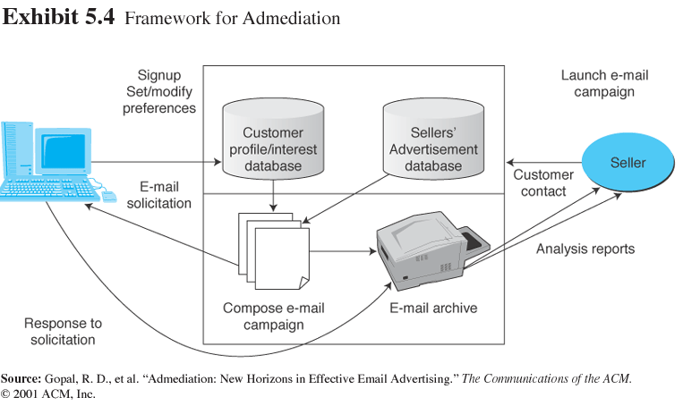
Advertising Strategies and Promotions (cont.)

Slide 38
Economics of Advertising
Pricing of advertising
Pricing based on ad views, using CPM
Pricing based on click-through
Payment based on interactivity
Payment based on actual purchase: affiliate programs

Slide 39
Economics of Advertising (cont.)
Advertising as a revenue model
many dot-com failures were caused by using advertising income as the major or the only revenue source
a small site can survive by concentrating on a niche area
playfootball.com

Slide 40
Economics of Advertising (cont.)
Measuring advertising effectiveness
Return on investment is used to measure the benefits received from their online advertising campaigns
Measuring, auditing, and analyzing Web traffic
Audience tracking

Slide 41
Special Advertising Topics
Permission advertising (permission marketing): Advertising (marketing) strategy in which customers agree to accept advertising and marketing materials
Ad management: Methodology and software that enable organizations to perform a variety of activities involved in Web advertising (e.g., tracking viewers, rotating ads)

Slide 42
Special Advertising Topics (cont.)
Features that optimize the ability to advertise online:
The ability to match ads to specific content
Tracking
Rotation
Spacing impressions

Slide 43
Special Advertising Topics (cont.)
Localization: The process of converting media products developed in one country to a form culturally and linguistically acceptable in countries outside the original target market
Internet radio: A Web site that provides music, talk, and other entertainment, both live and stored, from a variety of radio stations

Slide 44
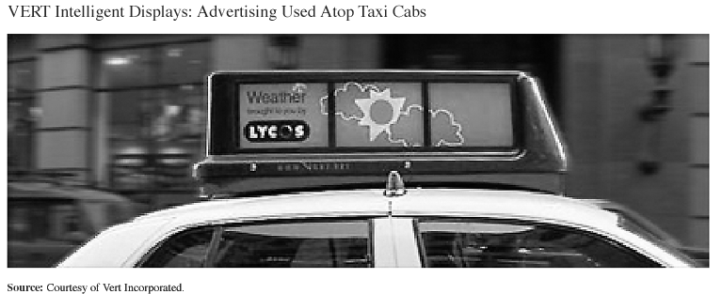
Special Advertising Topics (cont.)
Wireless advertising: content is changed based on the location

Slide 45
Special Advertising Topics (cont.)
Ad content
content of ads is extremely important
companies use ad agencies to help in content creation for the Web
Akamai Technologies, Inc. (akamai.com)
writing and editing of the advertising content itself is of course important
ebookeditingservices.com

Slide 46
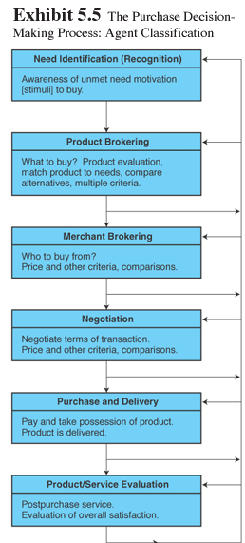
Software Agents in Customer-Related and Advertising Shopping

Slide 47
Software Agents in Customer-Related and Advertising Shopping (cont.)
Framework for classifying EC agents
Agents that support need identification (what to buy)
Agents that support product brokering (from whom to buy)
Agents that support merchant brokering and comparisons
Comparison agents

Slide 48
Software Agents in Customer-Related and Advertising Shopping (cont.)
Agents that support buyer–seller negotiation
Agents that support purchase and delivery
Agents that support after-sale service and evaluation

Slide 49
Software Agents in Customer-Related and Advertising Shopping (cont.)
Character-based animated interactive agents
Avatars: Animated computer characters that exhibit humanlike movements and behaviors
Social computing: An approach aimed at making the human–computer interface more natural
Chatterbots: Animation characters that can talk (chat)

Slide 50
Software Agents in Customer-Related and Advertising Shopping (cont.)
Agents that support auctions
act as auction aggregators, which tell consumers where and when certain items will be auctioned
Other EC agents
support consumer behavior, customer service, and advertising activities

Slide 51
Unsolicited Electronic Ads
UCE (unsolicited commercial e-mail)
Spamming: Using e-mail to send unwanted ads (sometimes floods of ads)
What drives UCE?
80 percent of spammers are just trying to get people’s financial information—credit card or bank account numbers—to defraud them

Slide 52
Unsolicited Electronic Ads (cont.)
Why is it difficult to control spamming?
spammers send millions of e-mails, shifting Internet accounts to avoid detection
use cloaking, they strip away clues (name and address) about where spam originates
server substitutes fake addresses
many spam messages are sent undetected through unregulated Asian e-mail routes
spamming is done from outside the U. S.

Slide 53
Unsolicited Electronic Ads (cont.)
Solutions to spamming
antispam legislation is underway in many countries
ISPs and e-mail providers (Yahoo, MSN, AOL)
junk-mail filters
automatic junk-mail deleters
blockers of certain URLs and e-mail addresses
Spam-filtering site for a country

Slide 54
Managerial Issues
Should we advertise anywhere but our own site?
What is our commitment to Web advertising, and how will we coordinate Web and traditional advertising?
Should we integrate our Internet and non-Internet marketing campaigns?

Slide 55
Managerial Issues (cont.)
What ethical issues should we consider?
Have we integrated advertising with ordering and other business processes?
How important is branding?
What is the right amount of advertising?
Are any metrics available to guide advertisers?

Slide 56
Summary
Objectives and characteristics of Web advertising.
Major online advertising methods.
Various advertising strategies and types of promotions.

Slide 57
Summary (cont.)
Measuring advertising success and pricing ads.
Permission marketing, ad management, and localization.
Intelligent agents.
Stopping unsolicited ads.

Slide 58

Selesai

